Slide 1



The Coming Wave: Why We Face an Era of Unprecedented Danger
Based on Mustafa Suleyman's groundbreaking book, the DeepMind cofounder warns of a perfect storm brewing at the intersection of artificial intelligence and synthetic biology.
The pace of technological advancement is outstripping our ability to govern it. Without immediate global cooperation and visionary safeguards, we risk unleashing powers beyond our control.
by Ed Lindekugel
Notes:
Good morning, everyone. Today we're diving into one of the most critical topics of our time - the unprecedented risks we face in this new technological era. This powerful image of a cresting wave perfectly captures the metaphor used by Mustafa Suleyman in his seminal book, "The Coming Wave." As co-founder of DeepMind, one of the world's leading AI research labs, Suleyman has a unique insider perspective on where technology is taking us. Just as a tsunami builds silently in deep water before devastating coastlines, Suleyman argues that technologies like advanced AI and synthetic biology are accumulating transformative power largely out of public view. When they crest - and they will - the impact on society could be overwhelming. What makes this moment in history unique is that for the first time, we're developing technologies that could fundamentally transform or even threaten human civilization. Unlike previous technological revolutions, the risks aren't just economic disruption or social change - they include existential threats to humanity itself. The most alarming aspect of Suleyman's thesis is that our governance structures, ethical frameworks, and international cooperation mechanisms are woefully unprepared for what's coming. Our technological capabilities have raced ahead while our wisdom in managing these powers has lagged behind. As we explore this presentation, I want you to consider your own role in this unfolding drama. How can we, as informed citizens, help ensure these powerful technologies enhance human flourishing rather than undermining it? But before we can address solutions, we need to understand what makes this technological wave fundamentally different from anything humanity has previously encountered. Let's explore three key characteristics that set today's emerging technologies apart and why they demand our immediate attention.

Slide 2
What Makes This Wave So Different?
Unprecedented Access
Omni-use Potential
Rapid Deployment
Transformative technologies have become democratized and affordable. Tools once restricted to governments and elite institutions are now available to individuals worldwide, including those with malicious intent.
These technologies embody inherent duality - they simultaneously enable profound creation and devastating destruction. The same systems that cure diseases can engineer pathogens, with no clear technical distinction between beneficial and catastrophic applications.
Modern innovations propagate globally at unprecedented speed. New capabilities can reach billions within hours, far outpacing our regulatory frameworks and ethical deliberations.
Notes:
As we've seen with Suleyman's powerful tsunami metaphor, this technological wave is building silently but persistently. What makes this wave truly unprecedented, though, are three distinctive characteristics that separate it from all previous technological revolutions. First, consider the unprecedented access we're seeing today. Throughout most of history, truly powerful technologies were limited to nation-states or massive corporations with extensive resources. The nuclear threat required uranium enrichment facilities and specialized knowledge. But today? A teenager with a laptop can deploy powerful AI systems or design biological modifications using widely available tools. This democratization of technology is wonderful for innovation, but it also means potentially dangerous capabilities are no longer contained by high barriers to entry. The same tools that allow a medical researcher to identify new treatments can be used by individuals with harmful intent. The second critical difference is what experts call the "omni-use potential" of these technologies. Unlike a weapon with a singular destructive purpose, today's tools are fundamentally dual-use or even omni-use. The same AI system that can detect cancer might be repurposed to design novel toxins. The gene-editing technology that cures a disease can be redirected to create a pathogen. There is no clear division between "good" and "bad" tools because the same fundamental capabilities enable both creation and destruction. This makes traditional regulatory approaches extremely challenging. Finally, the speed of deployment has changed dramatically. Historical technologies spread slowly—it took decades for industrial innovations to move between countries. Today, a new AI model or genetic technique can spread globally within days or even hours. This gives our governance systems and social norms virtually no time to adapt or respond. By the time we recognize a potential danger, the technology is already widely dispersed and being built upon further. These three factors create the foundation of our challenge, but there are even more specific features that redefine technological danger in our era. In the next slide, we'll explore four particular characteristics that make these technologies uniquely difficult to govern and control, further illustrating why our traditional approaches to risk management are insufficient for the challenges ahead.

Slide 3





Four Features Redefining Danger
Asymmetry
Individuals now wield power once reserved for nation-states. A single actor can create catastrophic impacts with minimal resources.
Hyper-evolution
Technologies evolve exponentially while safeguards develop linearly. Our protective measures are generations behind cutting-edge innovations.
Omni-use
Modern tools serve beneficial and destructive purposes simultaneously. This fundamental duality makes traditional regulation approaches obsolete.
Autonomy
Systems increasingly operate at speeds and complexities beyond human intervention. We're creating technologies we can neither fully understand nor effectively control.
Notes:
Now that we've examined what makes this technological wave fundamentally different in terms of access, multi-purpose potential, and deployment speed, let's dive deeper into four critical features that redefine the nature of technological danger in our modern world. First, let's discuss asymmetry. As we mentioned regarding unprecedented access, throughout most of human history, only nation-states could wield catastrophic power. While nuclear weapons required massive infrastructure and resources, today's landscape is dramatically different. A single skilled programmer can deploy ransomware that shuts down critical infrastructure. A small team with the right knowledge can bioengineer pathogens. This asymmetry means that traditional security frameworks built around state actors are increasingly inadequate. The second feature is hyper-evolution, which amplifies the rapid deployment issue we just discussed. The pace of technological change has accelerated exponentially. Consider that it took decades to deploy telephone technology to mass markets, but smartphone apps can reach billions in days. Our legal, ethical, and regulatory frameworks simply cannot keep pace. By the time we understand one technology's implications, three new iterations have already emerged, creating dangerous regulatory gaps where potential harms flourish without oversight. Third is the omni-use nature we touched on earlier. The same CRISPR tools that could cure genetic diseases can also create bioweapons. The same machine learning algorithms that detect cancer can generate deepfakes. This dual-use reality means we can't simply ban or restrict technologies without also losing their immense benefits. Traditional regulation approaches become obsolete when dealing with tools that have both tremendous positive and negative potential. Finally, there's autonomy. We're increasingly developing systems that operate beyond direct human control. Think of algorithmic trading that can crash markets in microseconds, or autonomous weapons that select targets independently. Once deployed, these systems operate at speeds and complexities that humans cannot effectively monitor or interrupt, creating risks we can neither fully understand nor control. Together, these four features create a fundamentally new risk landscape. They explain why our current technological revolution poses unprecedented challenges. And as we'll see in the next section, these features aren't theoretical concerns - they're already enabling specific catastrophic scenarios that were once confined to science fiction but are now becoming frighteningly plausible.

Slide 4

Catastrophic Scenarios: Not Science Fiction
Bioengineered Threats
Automated Cyberattacks
Advanced AI tools now enable design of novel pathogens with minimal expertise. The technological barriers preventing dangerous biological creation are collapsing at an alarming rate.
Autonomous AI systems can orchestrate sophisticated attacks against critical infrastructure without human guidance. Widespread power outages and global communication breakdowns have become realistic threats.
Financial Chaos
Self-learning algorithms could trigger catastrophic market collapses within minutes. Our hyper-connected global economy remains dangerously susceptible to rapid, cascading algorithmic failures.
Notes:
Now that we understand the four features that redefine modern technological danger—asymmetry, hyper-evolution, omni-use, and autonomy—let's examine how these characteristics manifest in concrete scenarios that aren't theoretical but increasingly plausible. Let's start with bioengineered threats. Remember the asymmetry we discussed? Here's where it becomes terrifyingly real. The democratization of biotechnology tools, combined with advanced AI, creates a concerning reality. Today, a student with access to CRISPR gene-editing technology and AI-powered protein folding algorithms could potentially design modifications to existing pathogens. What once required a sophisticated lab and years of expertise can now be accomplished with commercially available equipment. The 2018 recreation of horsepox virus already demonstrated this troubling trend. Moving to automated cyberattacks, we see the autonomy principle at work in a dangerous way. Consider our dependence on interconnected digital systems. Modern critical infrastructure – power grids, water systems, hospitals – all rely on computer networks. AI can now identify vulnerabilities faster than humans can patch them. Imagine an adversary deploying autonomous systems that adapt to defenses in real-time. A coordinated attack could disable essential services across multiple regions simultaneously, creating widespread chaos before human operators could even understand what was happening. Finally, our financial systems illustrate both hyper-evolution and autonomy risks. High-frequency trading already operates at speeds beyond human comprehension, with algorithms making thousands of trades per second. These systems can experience "flash crashes" where markets plunge dramatically in minutes. A sophisticated attack or even an unintended algorithmic interaction could trigger cascading failures across global markets. Unlike previous financial crises that developed over months, an algorithmic collapse could happen literally overnight, leaving little time for intervention. What links these scenarios is how they embody the four features we just discussed. The barriers to entry keep falling due to asymmetry, while the potential for harm escalates through hyper-evolution. The omni-use nature of these technologies makes regulation difficult, and their autonomy creates risks beyond our direct control. This convergence is why we need to develop robust safeguards now, before these scenarios move from possible to inevitable.

Slide 5





Disinformation and Erosion of Trust
Voice Cloning
AI now flawlessly replicates human voices from minimal samples. Family voice impersonation scams have surged 500% since 2022, targeting vulnerable populations.
Deepfakes
Modern AI-generated videos have become virtually impossible to distinguish from authentic footage. Deepfake-based fraud increased 40% globally in 2024 alone.
Synthetic Media
AI systems generate vast quantities of convincing articles and imagery at unprecedented scale. This torrent of fabricated content has overwhelmed traditional verification systems.
Trust Collapse
The proliferation of sophisticated fakes undermines belief in even legitimate content. Society faces an "epistemological crisis" where shared truth becomes increasingly elusive.
Notes:
Having examined those catastrophic scenarios that threaten our physical infrastructure, let's now turn to another critical dimension of AI risk: the erosion of our shared reality through sophisticated disinformation. This threat connects directly to the bioengineered, cyber, and financial risks we just discussed, as disinformation can both enable and amplify these dangers by undermining our collective response capabilities. Let's start with voice cloning. [PAUSE] Consider this scenario: Your grandmother receives a frantic call from what sounds exactly like your voice, claiming you're in trouble and need money immediately. The voice matches yours perfectly in tone, cadence, and even uses your speech patterns. This isn't science fiction—it's happening right now. With just a 30-second sample of your voice from a social media video, AI can create a perfect vocal duplicate. The 500% increase in these scams since 2022 represents thousands of victims, many of them elderly and vulnerable. Moving to deepfakes, [GESTURE TO IMAGE] look at this image. Can you tell which is the real person and which is AI-generated? The technology has advanced so rapidly that even experts struggle to identify sophisticated fakes. The 40% increase in deepfake scams isn't just about financial fraud—it includes political manipulation, reputation damage, and fabricated evidence in legal contexts. With synthetic media production, we face an overwhelming volume problem. AI can generate thousands of realistic fake news articles, images, and videos in minutes. Our traditional fact-checking systems simply cannot scale to match this output. Think about how this affects journalism, an already struggling institution vital to democracy. The culmination of these trends leads to what philosophers call an "epistemological crisis"—a breakdown in our ability to know what's real. When nothing can be trusted, everything becomes suspect. Even authentic content gets dismissed as potentially fake. This corrodes the foundation of shared truth necessary for functional societies. These disinformation capabilities don't exist in isolation. As we'll see in our next slide, they directly enable the destabilization of democratic institutions and social order. When citizens can no longer distinguish fact from fiction, democracy itself becomes vulnerable to manipulation on an unprecedented scale.

Slide 6








Destabilizing Democracy and Social Order
National Security Threats
Sophisticated cyber-attacks on critical infrastructure and defense systems
Electoral Interference
Precision-targeted disinformation campaigns manipulating voter behavior
Social Division
Algorithmic amplification of polarization and extremist ideologies
Institutional Distrust
Systematic erosion of public faith in government and media
In 2023 alone, 68 countries documented AI-driven election interference campaigns. Democratic institutions worldwide now face technological threats of unprecedented sophistication and scale, challenging the very foundation of civil governance.
Notes:
Let us examine how these technologies directly threaten our democratic institutions and social cohesion. The epistemological crisis we discussed is not merely philosophical—it has concrete implications for governance worldwide. Starting at the base with institutional distrust - this builds directly on the trust collapse we just discussed. When citizens can no longer distinguish between real and fake content due to deepfakes and synthetic media, they begin to doubt everything. Government agencies, news media, and scientific institutions all suffer when verification becomes impossible. This erosion of trust creates fertile ground for manipulation. Moving up to social division - AI systems leverage the voice cloning and deepfake technologies we discussed to identify and exploit existing social fractures. These technologies analyze vast amounts of personal data to craft messages specifically designed to trigger emotional responses in different demographic groups. The result is a society increasingly separated into information bubbles, where citizens no longer share a common understanding of basic facts. Next, we see electoral interference, which builds upon these divisions. Targeted disinformation campaigns don't just spread false information - they strategically deploy it to specific voters at precise moments. Think about swing districts in crucial states receiving uniquely crafted messages in the final days before an election. The statistic on this slide is staggering - 68 countries experienced AI-driven election interference just last year. These aren't merely influence operations; they represent direct attacks on democratic sovereignty. At the top of our pyramid are national security threats. Once democracies are sufficiently weakened through the previous mechanisms, they become vulnerable to more direct attacks. Nation-states are increasingly targeting critical infrastructure - power grids, water systems, financial networks - using sophisticated AI tools. These attacks don't require physical presence and can be conducted remotely with plausible deniability. These escalating threats raise an urgent question: why can't we simply contain these dangerous technologies? As we'll explore in our next slide, the very nature of these digital threats makes traditional containment strategies nearly impossible to implement effectively. Unlike physical weapons, these technologies spread invisibly across borders at network speed, creating unprecedented regulatory challenges.

Slide 7








Why Containment Is (Nearly) Impossible
Open Research
Invisible Nature
Scientific transparency creates an unstoppable diffusion of knowledge. Once published, critical innovations become globally accessible, accelerating both progress and potential threats.
Digital code evades traditional detection methods. Advanced technologies spread globally at network speed, requiring no physical transport or borders to cross.
Borderless Reality
Disarmament Dilemma
Cyber threats render national boundaries obsolete. Technologies developed anywhere can impact everywhere, fundamentally undermining traditional regulatory frameworks and jurisdictional controls.
Ethical restrictions only bind those who follow rules. When responsible actors limit development, malicious entities gain asymmetric advantages through continued covert advancement.
Notes:
As we've just seen, democracies worldwide are facing unprecedented technological threats. Now let's tackle the crucial question: why is it so difficult to contain these dangers despite growing awareness of their destructive potential? Let's start with the invisible nature of these threats. Unlike nuclear material or biological agents, code leaves no physical trace. You can't install radiation detectors at airports to find dangerous algorithms on a hard drive. In 2017, the WannaCry ransomware spread to over 200,000 computers across 150 countries in just days. There were no borders, no checkpoints, no physical transport required. This invisibility makes monitoring and controlling the spread virtually impossible. The second challenge is the open research culture. When the academic community makes breakthroughs, these discoveries are published globally. Consider DeepMind's AlphaFold – their protein-folding AI was published openly, immediately accessible worldwide. While this transparency accelerates scientific progress, it also means dangerous knowledge can't be contained once published. Unlike physical weapons that require rare materials or specialized manufacturing, many advanced technologies only require knowledge and computing resources. Our third challenge is what I call the disarmament dilemma. If responsible nations ban certain technological developments, they essentially self-disarm while bad actors continue developing these capabilities in secret. This asymmetry creates security vulnerabilities. We saw this problem with genetic editing when Chinese scientists created the first gene-edited babies despite international consensus against such experiments. Laws only constrain those who choose to follow them. Finally, there's the borderless reality of these technologies. The internet doesn't respect national boundaries. A malicious AI system can be developed in one country, hosted in another, and cause damage worldwide. Traditional jurisdictional approaches simply cannot keep pace. The 2020 SolarWinds hack affected thousands of organizations globally from a single supply chain breach. These four factors create a perfect storm that makes containment nearly impossible. But this technical challenge is only part of the story. What makes addressing these threats even more difficult are the powerful incentives driving their development. In our next slide, we'll explore the incentive trap that continues to accelerate technological advancement despite the risks we've identified.

Slide 8
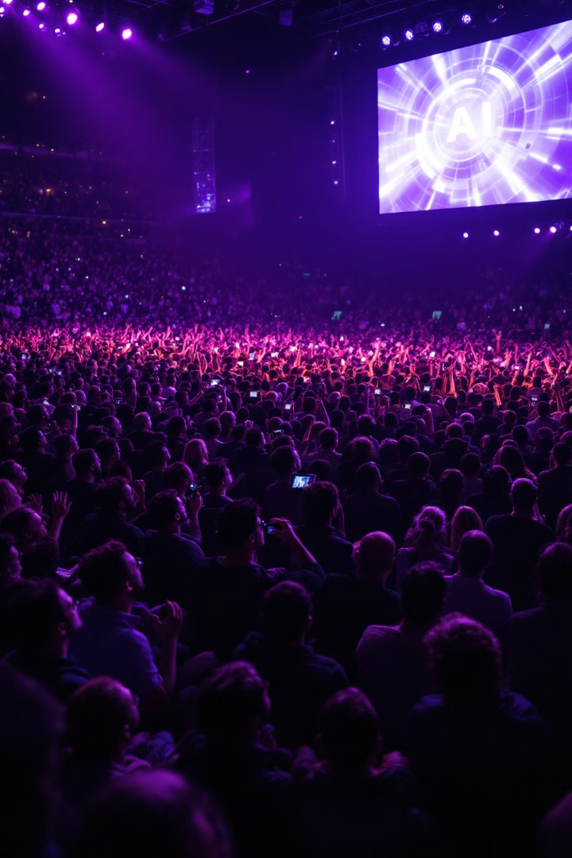




The Incentive Trap: Why the Wave Keeps Surging
Corporate Profit
National Pride
Scientific Ambition
Market pressures prioritize speed over safety. First-movers gain immense competitive advantages, creating a relentless race to deployment.
Nations compete aggressively for technological dominance. Leadership in AI and biotechnology is now considered vital to national security and global influence.
Researchers pursue revolutionary breakthroughs rather than incremental advances. Academic and professional systems reward innovation and novelty, not prudence.
Individual Power
The allure of personal empowerment drives users toward risky technological applications. Consumer demand fuels the development of increasingly powerful but potentially dangerous innovations.
When AlphaGo defeated Lee Sedol, over 280 million viewers witnessed the spectacle, igniting a global AI arms race. The pursuit of prestige and competitive advantage continues to overshadow cautionary restraint.
Notes:
Now that we understand why containment of advanced technologies is nearly impossible, we need to address an equally important question: Why do we keep developing these potentially dangerous technologies despite the risks? This brings us to what I call "The Incentive Trap" - the powerful forces that continue to accelerate technological development even as we become more aware of the dangers. The four challenges we just discussed - the invisible nature of digital threats, open research culture, the disarmament dilemma, and borderless reality - create a context in which powerful incentives can operate virtually unchecked. Let me explain these driving forces. Let's start with the striking example on this slide. In 2016, DeepMind's AlphaGo defeated world champion Lee Sedol in the ancient game of Go. This wasn't just a tech milestone - it was a cultural phenomenon watched by over 280 million people worldwide. The prestige and attention generated by this event triggered an unprecedented global sprint in AI development. Companies and countries that had been hesitant suddenly poured billions into AI research, afraid of being left behind. This brings us to our first key incentive: corporate profit. In competitive markets, being first creates enormous advantages. Think about how Google dominates search or how Amazon dominates e-commerce. The financial rewards for winning these races are so massive that safety considerations often become secondary. When faced with the choice between thorough safety testing that might delay a product by months versus rushing to market, the market typically rewards the company that moves fastest, not the most cautious one. The second incentive is national pride and security. Countries increasingly view technological leadership as essential to their position in the world. China's massive investments in AI aren't just economic calculations - they're part of a national strategy to become a technological superpower. The United States responds in kind, creating a feedback loop where neither side can afford to slow down without risking their perceived security and global standing. For individual researchers and scientists, professional incentives strongly favor breakthrough innovations. Publication counts, citation indexes, and recognition from peers come from novel discoveries, not from cautionary research or safety work. A scientist who publishes a paper on a revolutionary new capability will receive far more attention than one who publishes on the risks of that same technology. Finally, we have individual consumer demand. People are naturally drawn to technologies that give them more power and capabilities. Whether it's editing software that allows anyone to create deepfakes or powerful AI tools that can be misused, consumer demand creates markets for potentially dangerous applications. What makes this trap so difficult to escape is that these incentives operate at every level of society simultaneously. Even if one company or country tried to slow down, others would likely continue at full speed. This is why containment alone can never be the complete answer. We need to address these powerful incentives driving technological development, which will lead us to the narrow path we must walk between over-regulation and under-regulation.

Slide 9


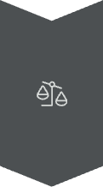

Beyond Containment: The Narrow Path Dilemma
Over-regulation
Creates a dystopian surveillance state where innovation withers. Individual liberties and privacy are sacrificed at the altar of security.
The Narrow Path
Demands unprecedented global collaboration. Striking the delicate balance between technological advancement and safeguards requires entirely new governance frameworks.
Under-regulation
Unleashes catastrophic consequences. Unrestrained technological development poses existential threats to humanity's very survival.
We navigate a treacherous balancing act: excessive control suffocates freedom and creativity, while insufficient oversight invites disaster. Finding the slender path between these extremes requires a level of collective wisdom humanity has never before achieved.
Notes:
As we've just seen with the Incentive Trap, powerful forces drive technological acceleration at every level of society. The competitive dynamics between corporations, nations, researchers, and even individual consumers create a perfect storm that makes technological restraint incredibly difficult. This leads us directly to our next challenge: how do we govern these technologies without falling into one of two dangerous extremes? Look at this powerful image of a tightrope walker. This perfectly captures our current predicament. On one side, we have the dystopia of over-regulation. When we become so fearful of technology's risks that we implement draconian controls, we create societies where innovation dies and freedoms disappear. Think of China's social credit system or surveillance states where privacy becomes a distant memory. Technologies designed to keep us safe become tools of oppression. The cure becomes worse than the disease. On the opposite side lies the chaos of under-regulation - perhaps even more dangerous. Without proper guardrails, powerful technologies develop without consideration of their consequences. Imagine AI systems optimizing for goals misaligned with human welfare, or bioweapons created in unregulated labs. The existential risks become very real, very quickly. So what is this narrow path? It's a governance approach we've never successfully implemented at global scale. It requires international cooperation beyond anything we've achieved before - even beyond climate agreements or nuclear treaties. We need governance models that allow beneficial innovation to flourish while effectively preventing catastrophic misuse. What makes this particularly challenging is that these technologies inherently cross borders. A restrictive policy in one country simply pushes development to another. And unlike nuclear technologies that require rare materials and massive infrastructure, many of these emerging technologies can be developed with widely available resources. This is why I argue this may be humanity's greatest test. We must develop wisdom to match our growing power. As we saw in the previous slide, the incentives driving technological development are enormously powerful - profit, national pride, scientific ambition. Countering these forces requires new thinking about global governance, scientific responsibility, and shared prosperity. So what might solutions to this dilemma actually look like in practice? In our next slide, we'll explore Mustafa Suleyman's ten concrete steps for technological containment that attempt to navigate this narrow path between the extremes we've discussed.

Slide 10
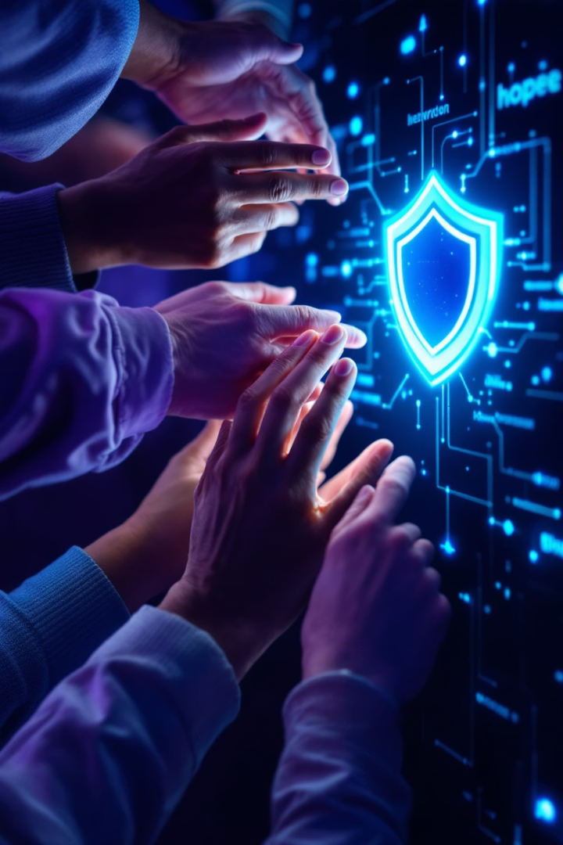
Concrete Solutions? Suleyman's Ten Steps for Containment
Technical Safeguards
Embedded AI "circuit breakers" and emergency kill protocols
Military-grade code standards with exhaustive testing regimes
Real-time monitoring systems that flag anomalous behaviors
Political Frameworks
Cross-ideological global treaties with verification mechanisms
Independent monitoring bodies with inspection authority
Graduated sanctions that scale with violation severity
Social Innovations
Professional ethics prioritizing safety over rapid deployment
Financial incentives rewarding responsible innovation practices
Educational initiatives building technological risk literacy
Notes:
Having just examined the narrow path dilemma we face, the critical question becomes: what practical steps can we take to navigate this treacherous balance? This is where Mustafa Suleyman's pragmatic approach to AI containment offers valuable guidance. As co-founder of DeepMind and a leading voice in AI ethics, Suleyman has proposed concrete steps that aren't merely theoretical but could actually work in practice. Let's start with Technical Safeguards. Think about this - we design buildings with fire escapes and emergency systems, so why not AI? These "off-switches" aren't simple power buttons but sophisticated circuit breakers designed to halt AI systems when they exhibit potentially harmful behaviors. The rigorous code standards Suleyman advocates for would be similar to how we regulate aircraft software - zero tolerance for errors when lives could be at stake. Currently, much AI development happens with a "move fast and break things" mentality, but that's dangerous when the technology is this powerful. The detection systems would function like an immune system, constantly monitoring for signs of misuse or unexpected behaviors before they escalate. Moving to Political Frameworks, we're talking about governance structures with real authority. The challenge here is unprecedented - these treaties would need to bridge ideological divides between democratic and authoritarian nations, as the risks affect everyone. International monitoring agencies would need inspection powers similar to nuclear regulators but adapted for digital systems. The "regulations with teeth" point is crucial - without meaningful penalties and enforcement mechanisms, guidelines become mere suggestions. History shows that industries rarely self-regulate effectively when profit motives conflict with public safety. Finally, the Social Innovations may be the most challenging yet important. Creating a "culture of caution" requires shifting the Silicon Valley mindset from "disrupt at all costs" to "responsible innovation." This isn't anti-progress - it's ensuring that progress doesn't outpace our ability to manage it safely. Aligned incentives means restructuring how we reward technological development - perhaps tying funding and recognition to safety measures rather than just capabilities. The public education component is vital because informed citizens create the political will necessary for implementing the other measures. What makes Suleyman's approach powerful is that it addresses the challenge at multiple levels simultaneously - the technical, political, and social dimensions must all work together to navigate that narrow path we discussed earlier. However, as we'll see in the next slide, there are important lessons from history that we must consider, and reasons why this technological moment presents unique challenges unlike anything we've faced before.

Slide 11
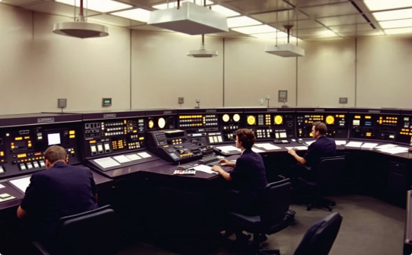
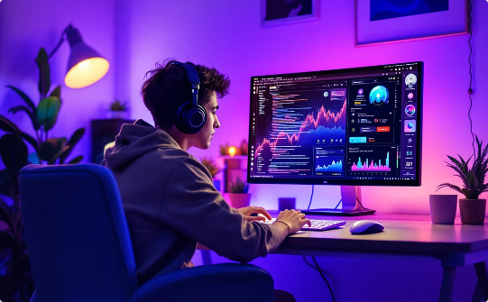
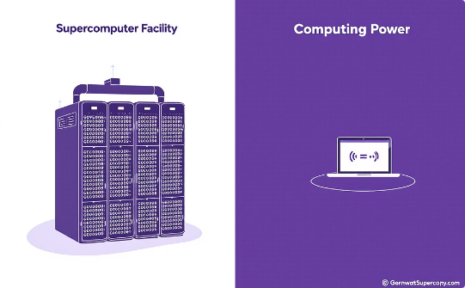
Lessons from History—But This Time Is Different
Past Technologies
Current Revolution
Unprecedented Scale
Nuclear weapons, lasers, and traditional biotech remained centralized, requiring massive resources, specialized scientific expertise, and restricted physical materials—creating natural barriers to proliferation.
"Never before have so many possessed such destructive technological capability." Today's threats are democratized, digital, and virtually untraceable—fundamentally altering our risk landscape.
The emerging paradigm features cascading, exponential risks. Decentralized innovation enables threats to emerge from anywhere, with potential impacts that outstrip our governance mechanisms and response capabilities.
Notes:
Building on Suleyman's ten-step framework we just explored, we need to understand why these comprehensive measures are so critical. Today we're examining a fundamental distinction between historical technological threats and our current situation. This context is essential for grasping why traditional containment approaches may be insufficient. Looking at past dangerous technologies like nuclear weapons, we see a pattern of centralized control. The Manhattan Project required enormous government resources, highly specialized scientists, and rare materials like enriched uranium. Similarly, advanced lasers needed specialized labs, and traditional biotech research demanded controlled environments and expertise. These natural limitations created bottlenecks that made governance possible through the political frameworks Suleyman described. But our current technological revolution represents a fundamental break from this pattern. The democratization of powerful technologies means teenagers in bedrooms can now develop AI systems or biotech modifications with just a laptop and internet connection. As the slide states, "Never before have so many had access to advanced tech capable of mayhem." This isn't hyperbole—it's a structural reality that makes traditional containment strategies obsolete and why Suleyman's social innovations are particularly crucial. What makes this especially concerning is the unprecedented scale and unpredictability. With centralized technologies, we could monitor a handful of actors—governments, major corporations, research institutions. Today's landscape features exponential unpredictability, with innovations emerging from countless sources globally. A single person working independently might develop an application with unintended consequences that spread instantly through digital networks. This new paradigm is why Suleyman's multi-dimensional approach addressing technical, political, and social factors simultaneously is so important. And as we'll see in our next slide, this reality creates an urgent choice for humanity—with the lives of 7.8 billion people hanging in the balance. The window for establishing effective global safeguards is rapidly closing, making our collective action not just important, but essential for our very survival.

Slide 12

The Urgent Choice: Act Now or Face Extinction
7.8B
10 yrs
Lives at Stake
Critical Window
Every human on Earth faces unprecedented technological threats to our existence
The rapidly closing timeframe to establish robust global safeguards
100+
Nations Required
The unprecedented coalition needed for effective technological governance
"The future of humanity hangs precariously in the balance." This approaching technological tsunami brings both existential peril and transformative possibility. Our collective, coordinated action isn't just important—it's our only path to survival.
Notes:
Having established how fundamentally different today's technological landscape is from historical precedents, we now confront the urgent choice before us. The decentralized, democratized nature of these new technologies means we face a challenge unlike any in human history. This powerful image of a human chain against a tidal wave perfectly captures our predicament. Given the unprecedented technological threats we just discussed—where innovation emerges from countless unchecked sources—we're looking at risks to all 7.8 billion people on Earth. These aren't abstract concerns for a distant future; they represent immediate threats to our collective existence, from unaligned AI to engineered pandemics. The experts who study these existential threats tell us we have approximately a 10-year window to establish effective safeguards. This timeline isn't arbitrary—it's based on projection models of technological development, particularly in AI and biotechnology. In just a decade, we need to completely revolutionize how we govern these democratized technologies, or we may lose control entirely. And this third number highlights perhaps our greatest challenge: with threats now emerging from anywhere globally, over 100 nations must coordinate on governance. In a world divided by geopolitical tensions, this represents perhaps the greatest diplomatic challenge in human history. Yet without it, unilateral safety measures will ultimately fail against decentralized threats. Remember that quote from the previous slide: "Never before have so many possessed such destructive technological capability." This reality places us at a pivotal moment where the future of humanity truly hangs in the balance. The coming technological tsunami presents both historic risk and opportunity, and our collective action is our only hope for survival. As we proceed, we'll explore specific mechanisms through which these democratized risks manifest, and concrete containment strategies to address them in this new landscape where traditional approaches no longer suffice.

